Slide 1
A Project on Internet Movies Dashboard Presented by: Snehal kore

Slide 2
Contents
Data Explanation
Dashboard
Insights

Slide 3
IMDB Dataset
Internet Movies Database
This dataset provides information on movies like
Name
Release date
Whether the movie is black & white or it is color movie
Genre (Type of movie)
Language
Actor, Director of Movie
Ratings
Likes, Reviews
Gross Revenue, Budget

Slide 4
Dashboard

Slide 5
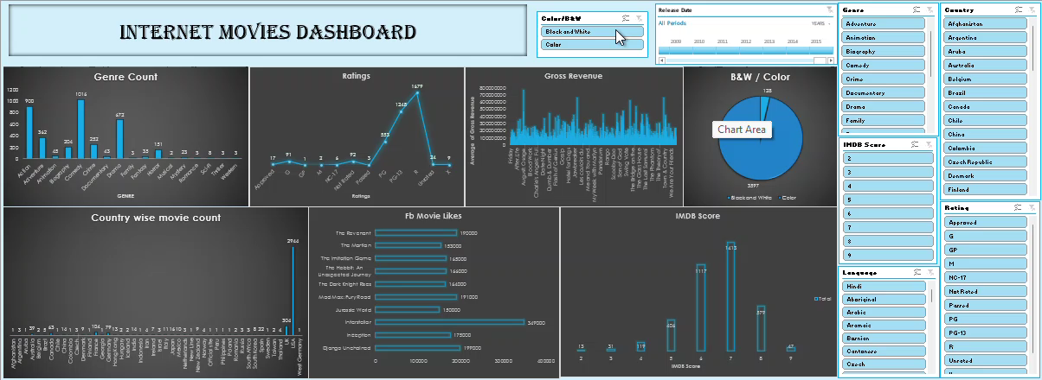
A short video of dashboard

Slide 6
insights
Genre of the movies
Togetherly the count of comedy movies is the highest than all other movies
In 2011 the count of action movies is highest than all other movies
Ratings
Here we came to know the total count of type of rating given to the movies
In 2011 "R" type of rating is given to total 66 movies. Out of that some are action movies, some are adventure, drama, comedy, crime, horror, and some are biography movies

Slide 7
Gross Revenue
In 2011 "Transformers: The dark of the moon" movie has the highest average gross revenue
In 2015 "Jurassic World" movie has the highest average gross revenue
B&W / Color
172 color movies and 2 B&W movies in 2011
126 color movies and 1 B&W movie in 2015
Country-wise movie count
Highest count of movies is from USA
In 2011 the total count of movies is 135 from USA, 14 from UK, 4 from France etc.

Slide 8
FB Movie Likes
"Drive" movie got the highest count of FB Likes in 2011
"Mad Max: Fury Road" got the highest count of FB Likes in 2015
IMDB Score
47 movies have IMDB score as 9
In 2011 only one movie got the IMDB score as 9
In 2015 not a single movie got IMDB score as 9

